Slide 1
DT– 9-Man Morris Sparrowhawks
Key Vocabulary
design | To plan and prepare something and decide on all the details of it.
carve | To change the shape of a piece of wood using a knife.
prototype | A first practise at making something before you make the real thing.
print | Transfer an image of something onto something else.
evaluate | To judge or assess the worth of something
research | To find out more about something.
product | Something that has been designed and made to be sold.
Key facts
The game goes back at least to Roman times is known by a number of different names in England - Nine Mens Morris or Morelles or or Merrills or Merels or Mill or just plain Morris.
As an old English game, it used to be played with black and white pebbles on a board marked out with a trowel dug into village greens as well as in Taverns on boards marked with chalk on a table. A carving of the game was even found on a Viking longboat.
The aim of the game is to get three tokens in a row. You place all your 9 tokens onto the board and take turns in moving them. When you achieve 3 in a row, you claim on of your opponent's tokens. The game is won when your opponent only has 2 tokens left or cannot make a move.

Slide 2
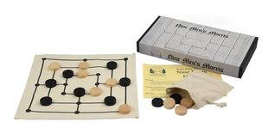
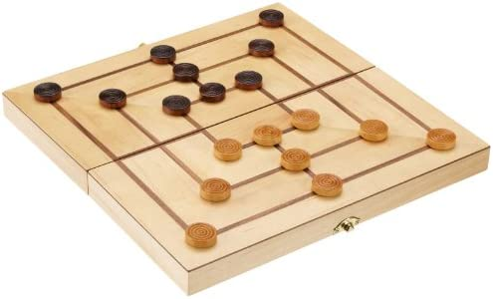
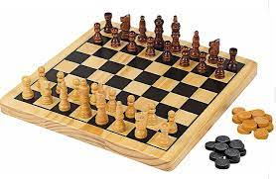
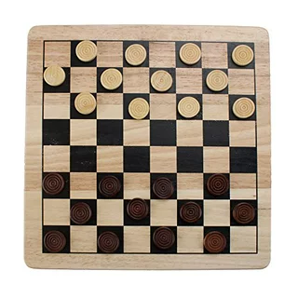
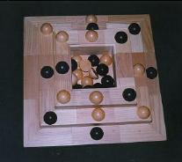
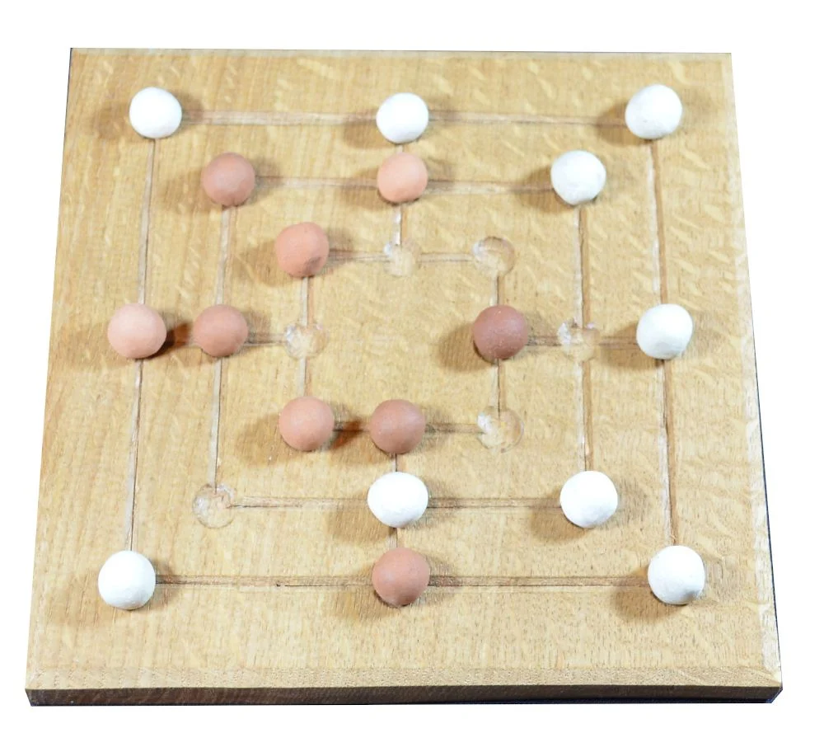
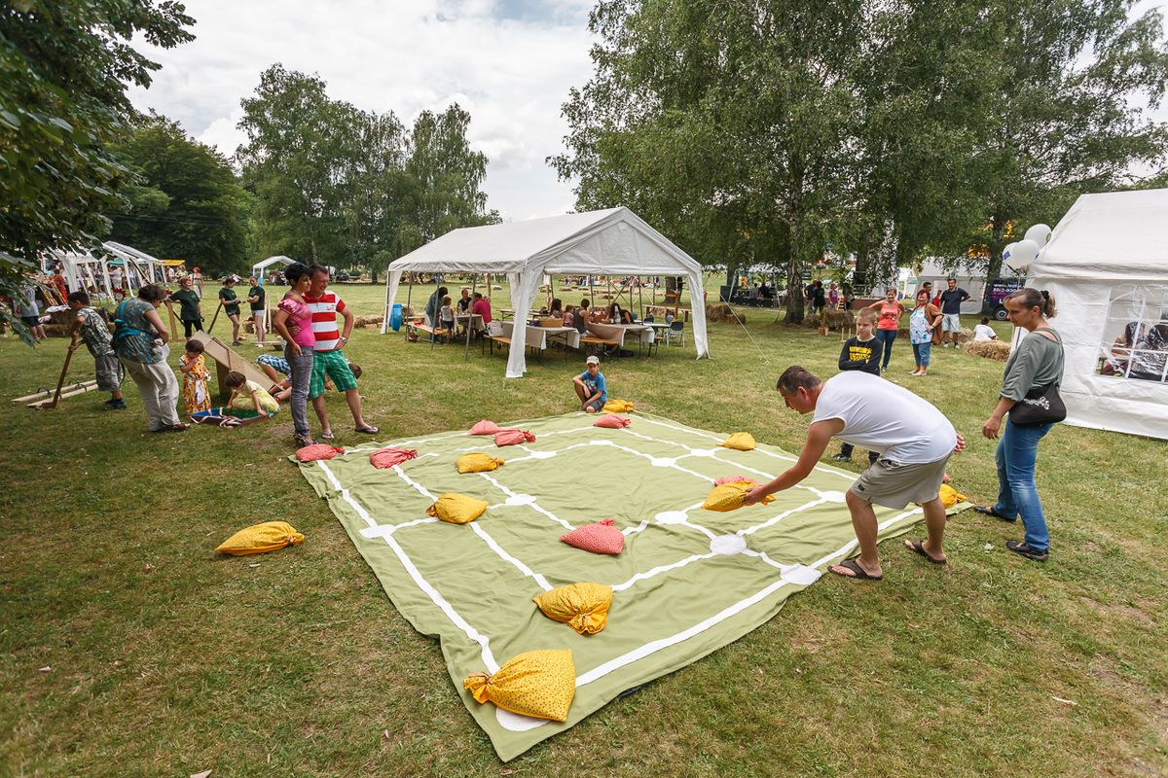
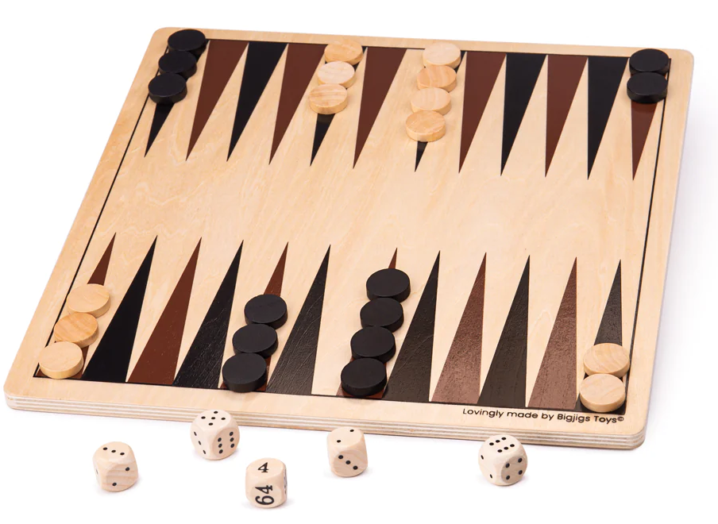
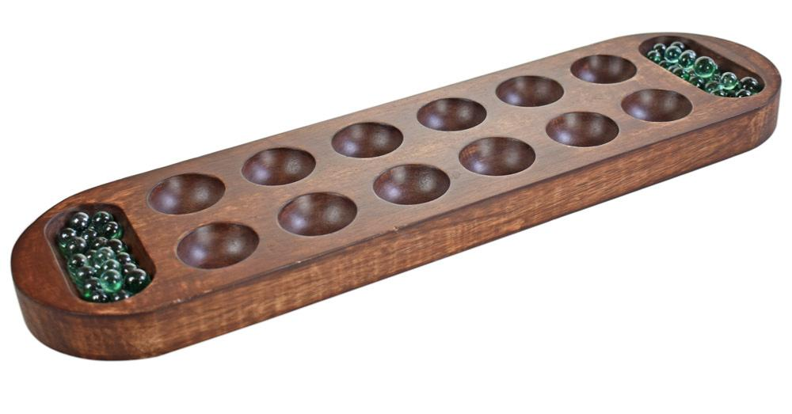
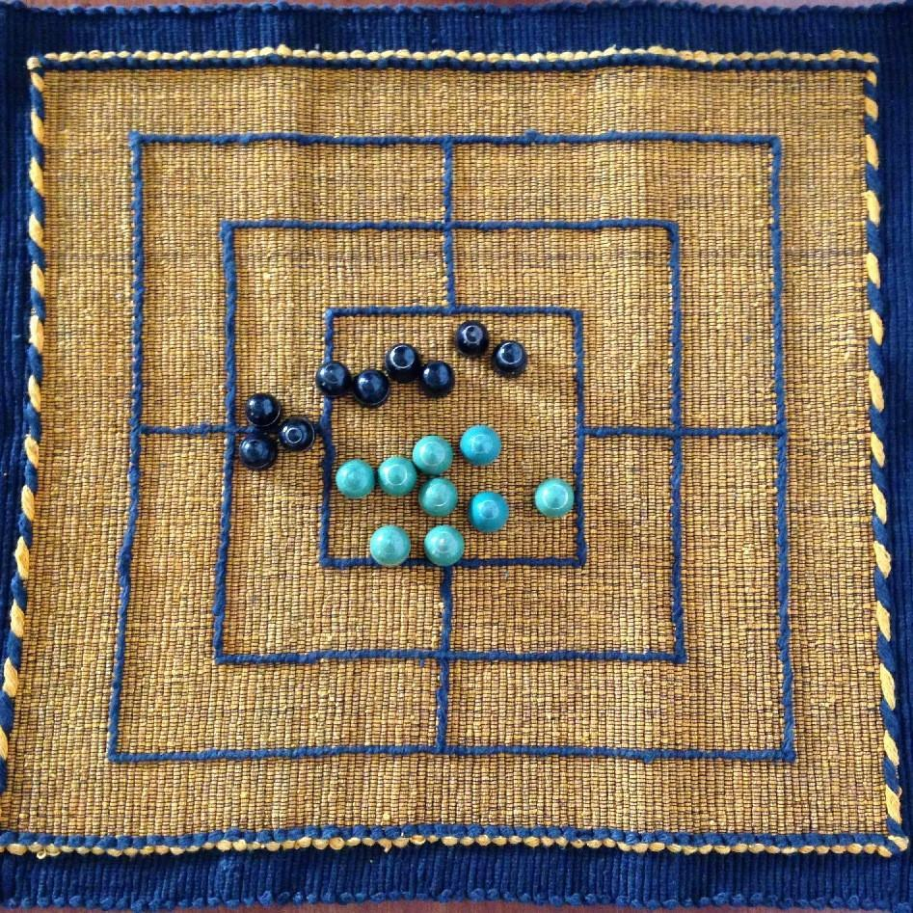
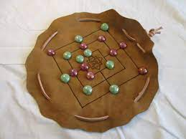
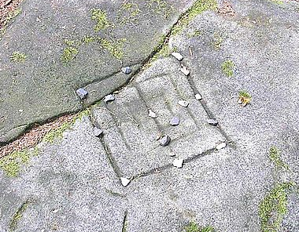
Traditional board games
9-Man Morris examples
Chess
Draughts
9-Man Morris
Mancala
Backgammon
Tier 2 vocabulary
manipulate | When you control someone, something or a situation.
criteria | A list of things that that need to be done.

