Slide 1
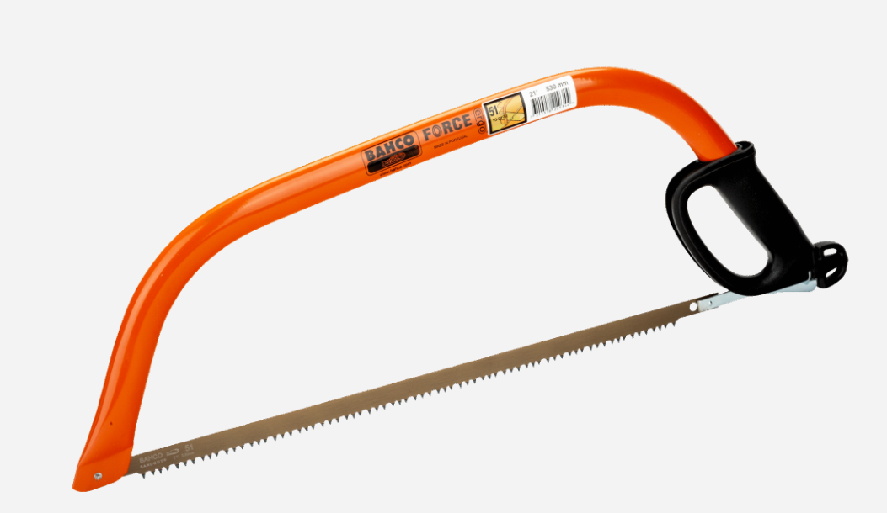
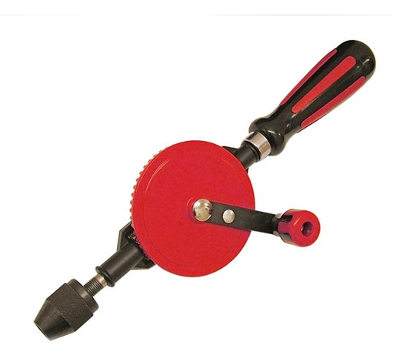
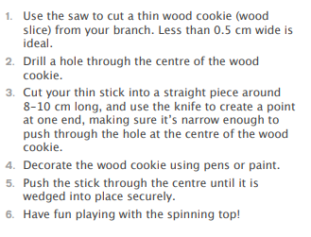
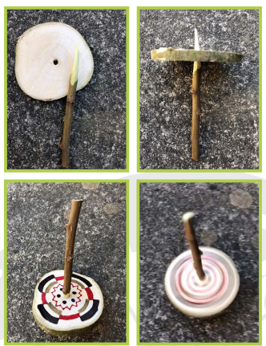
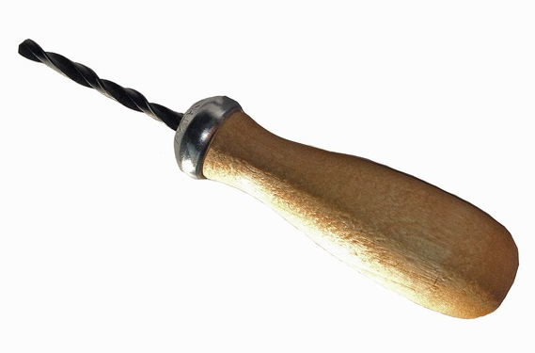
DT– Making Wooden Spinning Top Kestrels
Key Vocabulary
design | A drawing or plan to show the look and function of something.
evaluate | The process of deciding if something has been done in the best way and wondering what could be improved.
join | To fix two things together.
saw | To cut through something using a saw
materials | The matter from which a thing is or can be made from.
drill | To make a hole in something using a drill
tools | Something that is used or worked by hand to cut, fix or join materials.
Tools
Steps
Bow saw
Hand drill
Palm drill

