Slide 1
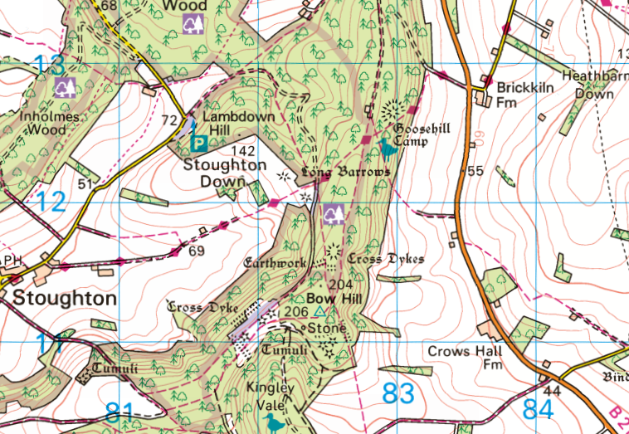
How does the quality of life vary between Bury, Slindon and Bognor Regis?
compass | A tool which shows you the direction of north to help with map reading.
coordinates | The location of a place on a map. You use write the number along the bottom of the map first and then the numbers up the side.
demography | The study of population.
migration | When people move from one area to another.
pull factors | Reasons to go to a new place; usually positive things about a place migrants are moving to.
push factors | Reasons to leave a place; usually negative things about a place which ‘push’ people away.
rural | The countryside.
rural idyll | The perception that rural areas offer a near-perfect life.
settlement | A place where people live.
urban sprawl | The uncontrolled physical expansion of the built-up area of a city into the surrounding rural area.
4-figure grid references
6-figure grid references
This 4 figure grid reference of this square is
81 11
The bottom left corner of the square is on the north-south line 81 and on the east-west line 11.
The 6 figure grid reference for this square is
83 5 12 4
The bottom left corner of the square is 5 parts
further east that the north-south line 83
83 5
And 4 parts further north that the east-west line 12
12 4
9
8
7
7
5
4
3
2
1
0
0 1 2 3 4 5 6 7 8 9
Tier 2 words
benefit | Something good that can happen as a result of something else.
environment | The surroundings or conditions in which a person, animal or plant lives.
justify | To explain what you think with reasons.
perspective | Someone's point of view or opinion.
82

Slide 2
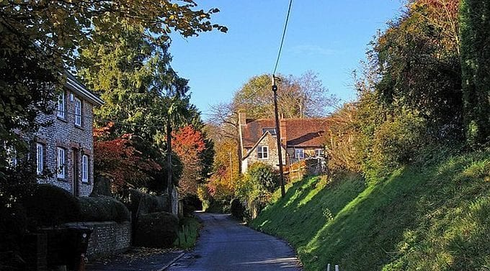
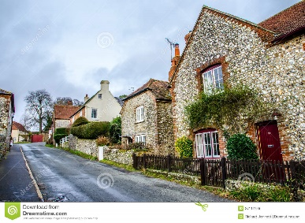
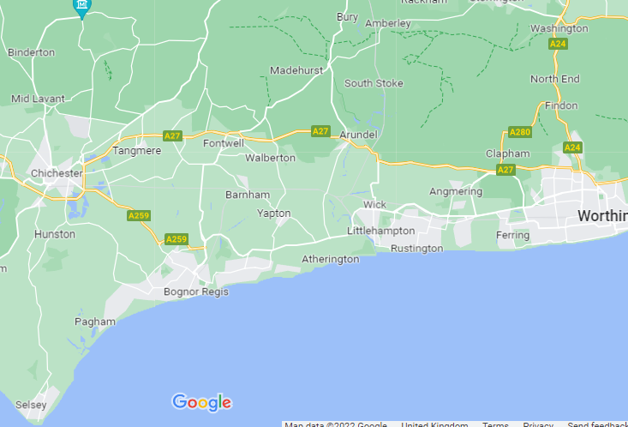
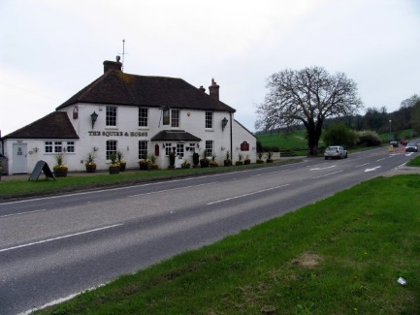
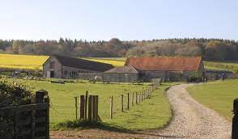
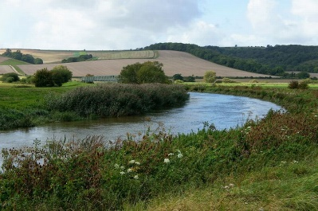
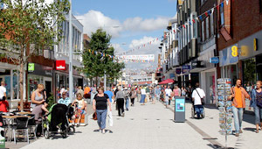
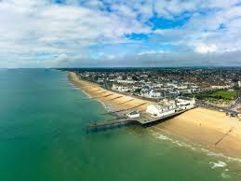
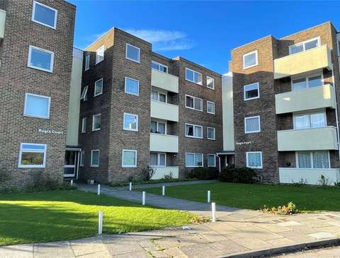
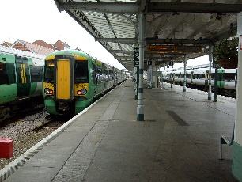
Slindon
Key Facts
People choose to live where they do for a variety of reasons.
Bury
There are a lot of pretty older houses in Bury.
Most of Bury village is on a quiet road parallel to
the busy A29.
Flint cottages mostly owned by the Slindon Estate National Trust. Many people in Slindon rent their houses from the National Trust.
Located on the top of the South Downs.
A lot of tourists visit Slindon because it is very pretty and has good access to the South Downs on footpaths and bridleways.
Clear views to the sea in the South and the North Downs in the north.
There is a pub situated on the A29.
The river runs through the village but there
is no crossing point to Amberley anymore.
Bognor Regis
There are good transport links by bus and train.
There is a town centre with lots of shops and services.
There are a variety of places to live from flats to large houses.
Tourists visit for the beach and for Butlin’s holiday camp.

