Slide 1
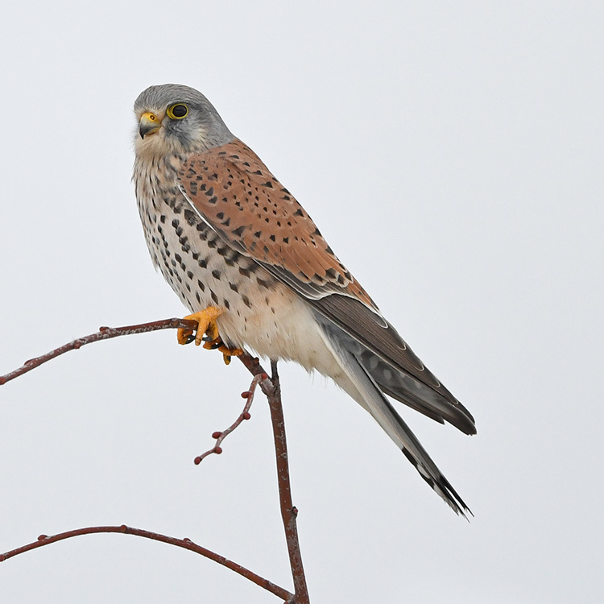
Kestrel Class
Teachers
Miss Willett (Monday to Thursday)
Mrs Gammon (Friday)
Teaching Assistant
Mrs Hubbard (all week)
2025-'26

Slide 2
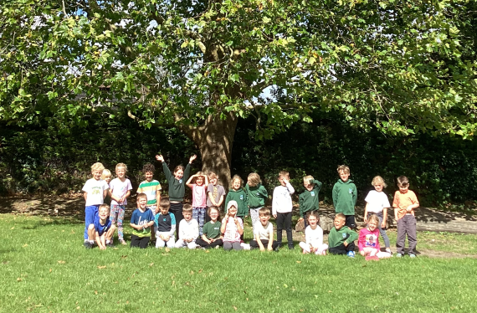

Slide 3
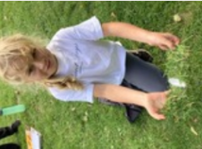
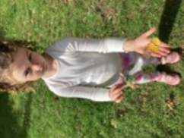
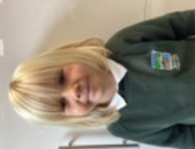
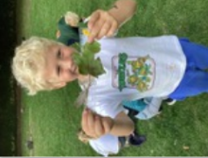
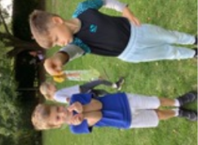
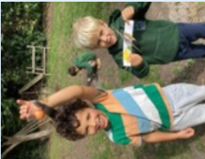
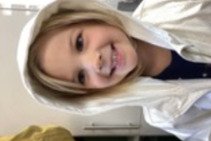
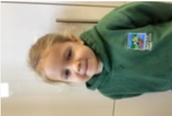
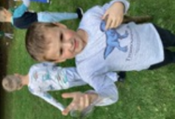
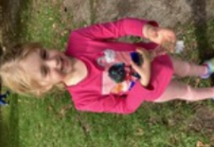

Slide 4
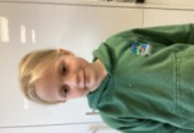
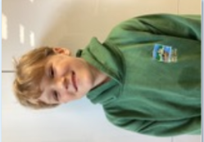
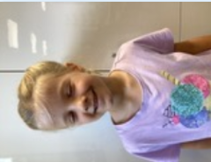
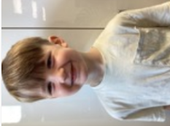
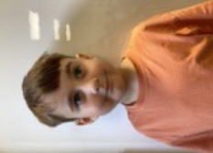
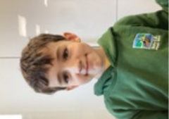
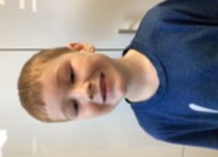
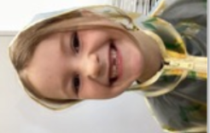
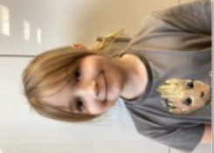
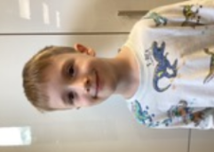
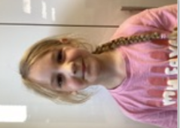
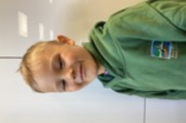
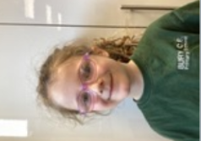

Slide 5
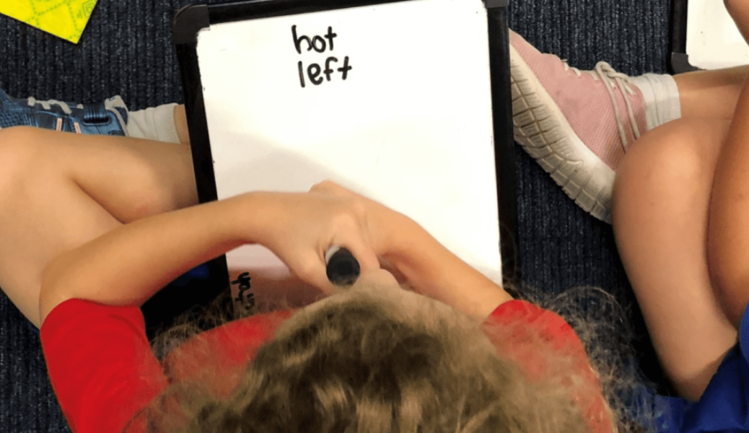
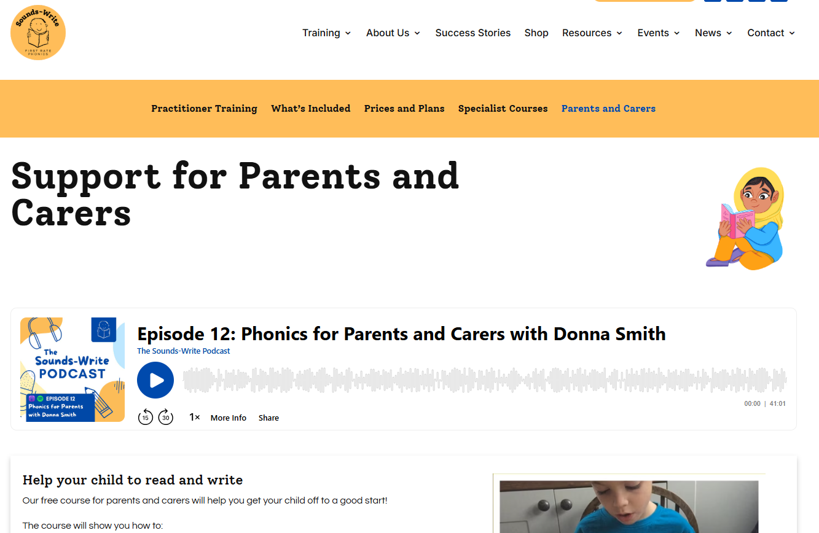
Phonics in Year 1&2
Sounds Write Phonics Scheme
Parent Phonics Workshop – Details will follow soon

Slide 6

Year 1 Phonics Screening
The week of Monday 8 June 2026.
It is designed to give teachers and parents information on how your child is progressing in phonics.
It will help to identify whether your child needs additional support at this stage so that they do not fall behind in this vital early reading skill.
There are two sections in this 40-word check.
Your child will read up to four words per page for their teacher and they will probably do the check in one sitting of about 5–10 minutes.

Slide 7


English in Year 1&2
Writing sentences
Writing poems

Slide 8
Year 1 Writing
Leave finger spaces between words.
Use the word and in sentences.
Capital letters
Full stop
Question mark
Exclamation mark
Year 2 Writing
Types of sentences: statements, questions, exclamations, commands
Punctuation: commas, apostrophes
Expanded noun phrases
Adjectives
Verbs
Conjunctions – when, if, that, because, or, and, but
We will send home a copy of the year 1 and year 2 common exception words

Slide 9
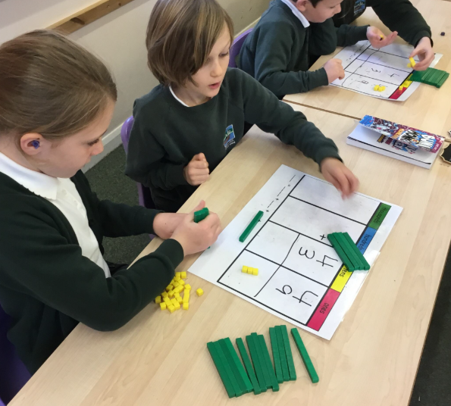


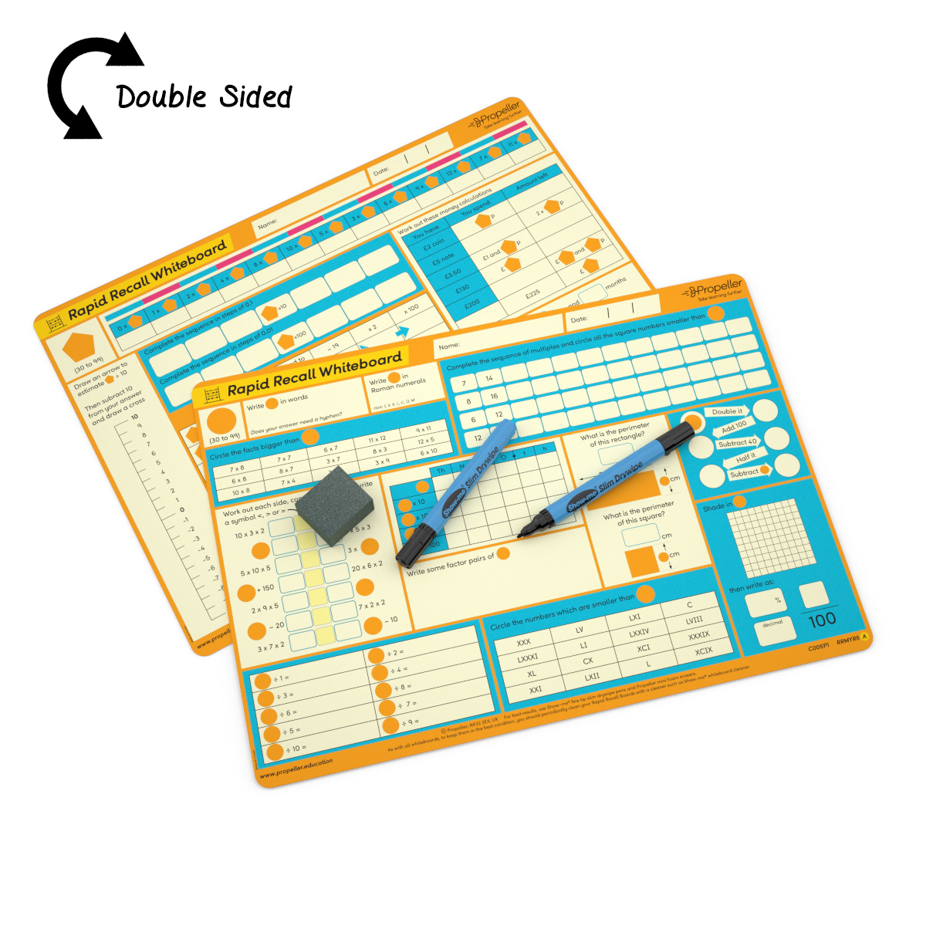
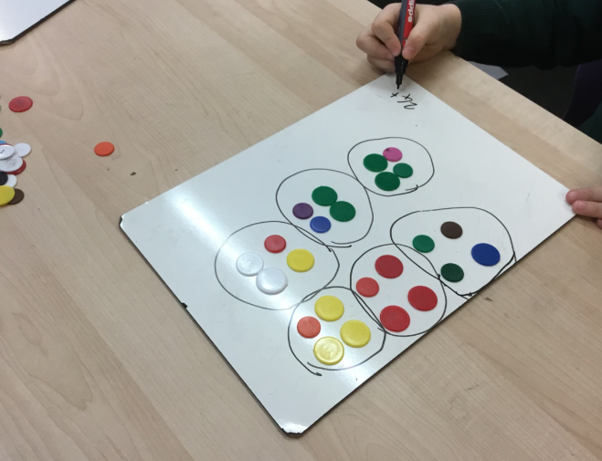

Maths in Year 1&2
We use Maths – No Problem! as our main maths scheme but we also use a variety of other games, activities and resources to compliment and extend the children's learning.

Slide 10
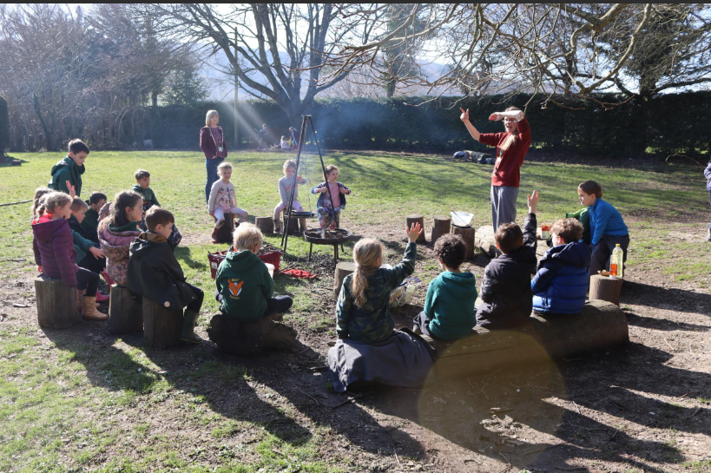
Bury Rangers
Science
Plants
Materials
Animals
Design Technology
Building dens
Cooking on the fire
Making bird feeders
Whittling journey sticks

Slide 11
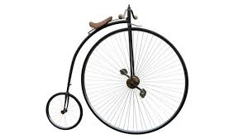
Geography and History in Year 1&2
Autumn Term
Geography & History: Brilliant Bury
Spring Term
History: Florence Nightingale and Mary Seacole
Geography: Would you rather live in Rome or Bury?
Summer Term
History: History of transport (trip to Amberley museum)

Slide 12
Uniform and Equipment
Uniform:
Bottle green cardigan or sweatshirt embroidered with school logo.
Grey skirts, gingham green dress, grey trousers or shorts.
White button necked polo shirt, grey or white socks or bottle green/grey tights.
Suitable dark shoes. Sling back shoes, open toes and heels are not allowed.
PE Kit (Monday and Wednesday)
Green T-shirt, black shorts (track suits may be worn in the winter for outside lessons), plimsolls or trainers.
Bury Rangers (Tuesday)
Wellington boots, outside clothing appropriate to the weather conditions, Bury Rangers hoodies can also be bought as an additional option and worn for Bury Rangers or PE.

Slide 13
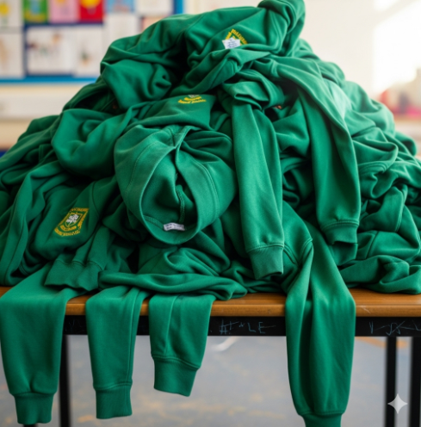
Please name all their belongings, they all look the same!

Slide 14
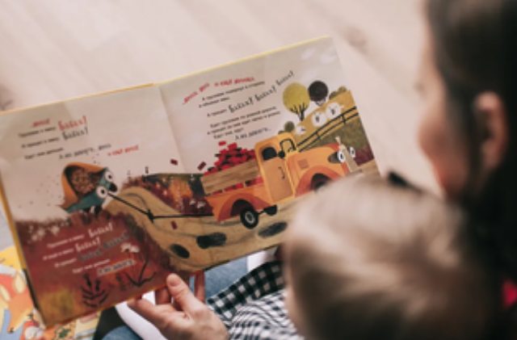
Home Learning
Reading for just 10 minutes every day makes a HUGE difference.
Learn more in all subjects
empathy
confidence
Wider vocabulary
Support play
imagination
Expand horizons
Better able to express themselves

Slide 15
Getting involved
Helpers on trips – we often need some parent support for trips and will email details of these out when needed
Everybody read – parents are invited to come and share books with us once a week (details TBC)
Reading volunteer – if you would like to listen to readers regularly, email the office.
Special hobbies or jobs – If you have any interesting hobbies or jobs that would be great for the children to learn about, please let us know!

Slide 16
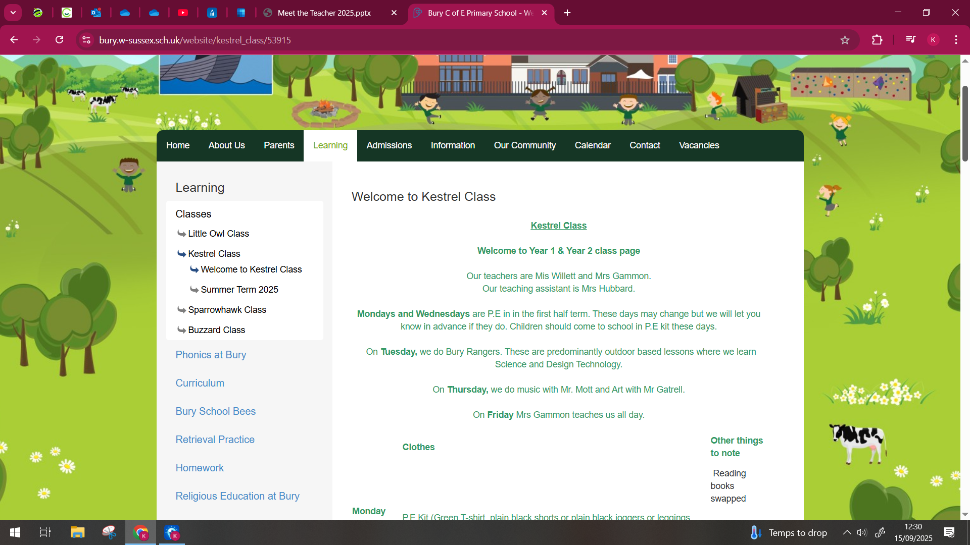
How do I know how and what my child is doing?
2 parent consultations (October and Spring term)
End of year written report
Webpage
https://www.bury.w-sussex.sch.uk/website/kestrel_class/53915

