Slide 1
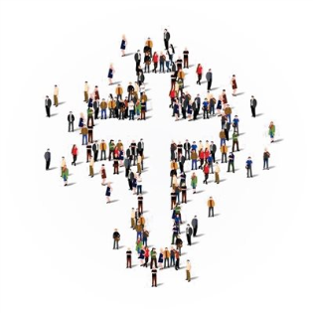
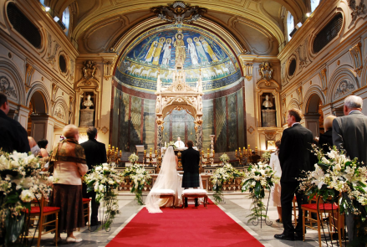
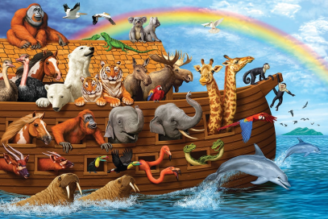
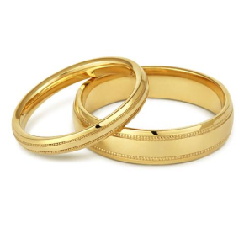
Key Vocabulary |  | Key Facts
Israel | Kingdom in ancient Palestine comprising the lands occupied by the Hebrew people | The Old Testament tells the story of a particular group of people, the children of Israel known as the People of God – and their relationship with God.
pact | An agreement between individuals. | The People of God try to live in the way that God wants, following his commands and worshipping him.
covenant | An agreement. | They believe he promises to stay with them and Bible stories show how God keeps his promises.
wedding | A marriage ceremony.
ceremony | A formal religious occasion celebrating a particular event. | Pictures
symbols | A thing that represents or stands for something.
Key People
Noah | A person from the Old Testament who saved himself, his family and different species of animal from a flood by building an ark.
People of God | A description that in the Old Testament applies to the Israelites and that the New Testament applies to Christians.
Jew | A member of the people and cultural community whose traditional religion is Judaism.

